Slide 1
Availability
—— 2018/3
Huangwu
64

Slide 2

Problem
How do you promise the software continues correctly run if the hardware was collapsed？
How do you prevent the error of your algorithm?
64

Slide 3
Outline
Introduction
Planning for failure
Availability General Scenario
Tactics for availability
A design checklist for availability
Summary
64

Slide 4
1. Introduction
Availability refers to a property of software that it is there and ready to carry out its task when you need it to be
Availability refers to the ability of a system to mask or repair faults such that the cumulative service outage period does not exceed a required value over a specified time
64

Slide 5
1.1 Attribute and Other Concepts
Dependability is the ability to avoid failures that are more frequent and more severe than is acceptable
Availability builds upon the concept of reliability by adding the notion of recovery, that is, when the system break, it repairs itself
Availability = reliability + recovery
64

Slide 6
1.2 Availability and other Quality Attributes
Availability and security
A denial-of-service attack is explicitly designed to make a system be unavailable
Availability and performance
When a system was outrageously slow to respond it is unavailable
64

Slide 7

1.3 Faults and Failure
Failure implies visibility to a system or human observer in the environment
A failure’s cause is called fault
A fault can be either internal or external to the system under consideration
Intermediate states between the occurrence of a fault and the occurrence of a failure are called error
64

Slide 8
1.4 Availability and Faults
Availability is about minimizing service outage time by mitigating faults
Faults can be prevented, tolerated, removed, or forecast
The distinction between faults and failures allows discussion of automatic repair strategies
64

Slide 9
1.5 Areas of Concern in Availability
How system failure is detected
How frequently system failure may occur
What happens when a failure occurs
How long a system is allowed to be out of operation
How failures can be prevented
…
64

Slide 10
1.6 Availability Represent
Availability can be calculated as a probability
Availability = MTBF / ( MTBF + MTTR)
MTBF is mean time between failures
MTTR is mean time to repair
Availability can be represented a probability, such as 99.9, 99.99 etc.
64

Slide 11

1.7 Service-Level Agreement
Availability provided by a system or hosting service is frequently expressed as a service-level agreement ( SLA )
The SLA specifies the availability level that is guaranteed and penalties will suffer if the SLA is violated
64

Slide 12

1.7.1 The Amazon’s SLA
The SLA that Amazon provides for its EC2 cloud service is:
AWS(Amazon Web Services) will use commercially reasonable efforts to make Amazon EC2 available with an Annual Uptime Percentage of at least 99.95% during the Service Year…
64

Slide 13
1.8 Availability class
Availability Class | System Type | Unavailable (min/year) | Availability
1 | Unmanaged | 50,000 | 90%
2 | Managed | 5,000 | 99%
3 | Well Managed | 500 | 99.9%
4 | Fault Tolerant | 50 | 99.99%
5 | High-Availability | 5 | 99.999%
6 | Very-High-Availability | 0.5 | 99.9999%
7 | Ultra-Availability | 0.05 | 99.99999%
High Availability is 99.999%
64

Slide 14

2. Planning for Failure
For every system, the failure is inevitable
Planning for failure is for handling the failures with aplomb
The first step to handle the failures is to understand what kinds of failures(cause) your system is prone to, and what the consequences(effect) of each will be
64

Slide 15

2.1 Hazard Analysis
Hazard analysis is a technique that attempts to catalog the hazards that can occur during the operation of a system
It categorizes each hazard according to its severity
64

Slide 16
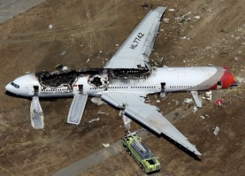
2.1.1 Example of category
DO-178 standard used in the aeronautics industry
Catastrophic: failure may cause a crash
Hazardous: failure has large negative impact on safety or performance
Major: failure has a lesser impact than hazard
Minor: failure is lesser impact than major
No effect: failure has no impact on safety
64

Slide 17

2.2 Fault tree analysis
Fault tree analysis is an analytical technique that specifies a state of the system that negatively impacts safety or reliability, and then analyzes the system’s context and operation to find all the ways that the undesired state could occur
The technique uses a graphic construct
64

Slide 18
2.3 The example of FTA
D Fails
G1
A Fails
B or C Fail
A
G1
B Fails
C Fails
B
C
A simple fault tree. D fails if A fails and either B or C fails ( come from NASA handbook )
64

Slide 19
2.4 FMECA
A fault tree not only lends to static analysis, but also lends to dynamic analysis (Markov analysis)
Failure Mode, Effects, and Criticality Analysis(FMECA) catalogs the kinds of failures
FMECA relies on the history of failure of similar systems in the past
64

Slide 20
2.5 Example of FMECA
Table Failure Probabilities and Effects
Compo-nent | Failure Probability | Failure Mode | % Failures by Mode | Effects
 |  |  |  | Critical | Noncritical
A | 1 x 10⁻³ | Open | 90 |  | X
 |  | Short | 5 | X (5 x 10⁻⁵)
 |  | Other | 5 | X (5 x 10⁻⁵)
B | 1 x 10 ⁻³ | Open | 90 |  | X
 |  | Short | 5 | X (5 x 10⁻⁵)
 |  | Other | 5 | X (5 x 10⁻⁵)
Above probability of a critical system failure:
4 x ( 5 x 10⁻⁵ ) = 2 x 10⁻⁴
64

Slide 21

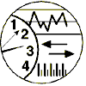
3.Availability General Scenario
General scenario of availability with parameters
Artifact:
Process, Storage, Processor, Communication
Stimulus:
Response：
(Fault)
Omission, Crash, Timing, Response
Record, Notify, Disable, Continue(Normal/Degraded) Be Unavailable
Response measure：
Source:
Environment:
Internal, External
Normal, Degraded Operation
Repair, Time, Availability, Available Degraded Time Interval
64

Slide 22
3.1 General Quality-Attribute Table of Availability
Portion of Scenario | Possible Value
Source | Internal to the system; external to the system
Stimulus | Fault: omission, crash, timing, response
Artifact | System's processors, communication channels, persistent storage, processes
Environment | Normal operation; degraded mode
Response | System should detect event and do one or more of the following: record it; notify appropriate parties; disable sources of events, continue to operate in normal or degraded mode
Response Measure | Time interval when the system must be available ; Availability time Time interval in which system can be in degraded mode; Repair time
64

Slide 23

3.2 Stimuli of Availability
Omission：A component fails to respond to an input
Crash：The component repeatedly suffers omission faults
Timing：A component responds but the response is early or late
Response：A component responds with an incorrect value
64

Slide 24
3.3 A Concrete Scenario of Availability
Artifact:
Process
Response：
Stimulus:
Unanticipated message
Inform operator continue to operate
Response measure：
Source:
Environment:
External to system
Normal operation
No downtime
An unanticipated external message is received by a process during normal operation. The process informs the operator of the receipt of the message and continues to operate with no downtime
64

Slide 25

4. Tactics for Availability
Availability tactics are designed to enable a system to endure system faults so that a service being delivered by the system remains compliant with its specification
64

Slide 26
4.1 Goal of Availability Tactics
The availability tactics will keep faults from becoming failures or at least bound the effects of the fault and make repair possible
Fault
Tactics to Control Availability
Fault masked or Repair Made
64

Slide 27
4.2 Categories of Availability Tactics
Availability tactics includes three Categories：
Fault Detect——Health monitoring to detect a failure
Fault Recovery——Recover when a failure is detected
Fault Prevention——Prevent fault to become failure
64

Slide 28
4.2.1 The Graph of Classifying Availability Tactics
Availability
Fault Detection
Recovery-Preparation and Repair
Recovery-Reintroduction
Prevention
Fault Masked or Repair Made
Ping/Echo
Monitor
Heartbeat
Sanity Checking
Timestamp
Exception Detection
Voting
Self-Test
Active Redundancy
Passive Redundancy
Spare
Rollback
Exception Handling
Software Upgrade
Degradation
Shadow
State Resynchronization
Escalating Restart
Non-Stop Forwarding
Removal from Service
Transactions
Predictive Model
Exception Prevention
Increase Competence Set
Fault
Availability tactics
64

Slide 29

4.3 Fault Detection
Before any system can take action regarding a fault, the presence of the fault must be detected or anticipated
Tactics of this category include:
Ping/echo
Monitor
Heartbeat
Time stamp
Sanity checking
Condition monitor
Self-test
Voting(Replication, Functional Redundancy, Analytic Redundancy)
Exception detection(System exceptions, The parameter fence, Parameter typing, Timeout)
64

Slide 30

4.3.1 Ping/Echo
ping/echo: An asynchronous request/response message pair exchanged between nodes
Used to determine reachability and the round-trip delay through the associated network path
Ping/echo requires a time threshold
The tactics take active mode, similar to take attendance in the course
64

Slide 31

4.3.2 Monitor
Monitor: A monitor is a component that is used to monitor the state of health of various other parts of the system: processors, processes, I/O, memory, and so on
A system monitor can detect failure or congestion in the network or other shared resources, such as from a denial-of-service attack
64

Slide 32

4.3.3 Heartbeat
Heartbeat：a fault detection mechanism that employs a periodic message exchange between a system monitor and a process being monitored
The heartbeat can also carry data
The tactics take passive mode, similar to hear report
The ping/echo and heartbeat tactics operate in different processes
64

Slide 33

4.3.4 Sanity Checking
Sanity checking checks the validity or reasonableness of specific operations or outputs of a component
This tactic is typically based on a knowledge of the internal design
For example
int Get_Human_Temperature() is limited in the 33 °C – 45 °C
64

Slide 34

4.5 Voting
Voting based on the redundant
The most common realization of this tactic is referred to as triple modular redundancy(TMR)
Faced with an inconsistency, the voter reports a fault and decides what output to use, such as majority rule or average
64

Slide 35
4.5.1 Categories of voting
The voting can be fined below:
Replication for checking hardware error, same input and output
Functional redundancy check model-mode failure, same input, different algorithm, and the same output
Analytic redundancy, different input, complex computer output
64

Slide 36
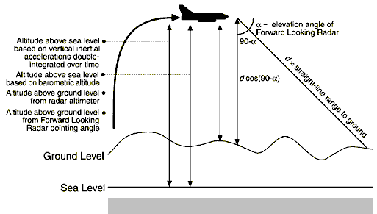
4.5.2 four methods of Calculating flight altitude
Key data is reliable
64

Slide 37
4.3.6 Exception Detection
Exception detection refers to the detection of a system condition that alters the normal flow of execution
The tactic can be refined below:
System exceptions, such as divide by zero
The parameter fence incorporates an a priori data pattern, such as 0xDEADBEFF
Parameter typing checking the type-length-value(TLV), strong type
Timeout check the timeout
64

Slide 38

4.4 Fault Recovery
Fault recovery consists of preparing for recovery and making the system repair
Preparing for recovery include Active redundancy, Passive redundancy, Spare and Exception handling etc.
Reintroduction includes Shadow, State resynchronization, escalating restart and Non-Stop forwarding ( NSF )
64

Slide 39
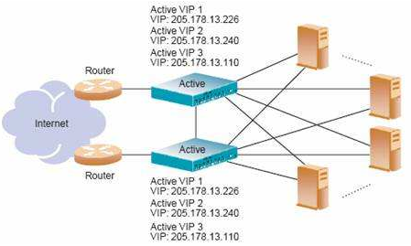
4.4.1 Active redundancy
Active redundancy：All redundant components respond to events in parallel
They are all in the same state, using this tactic is usually milliseconds since the backup is current and the only time to recover is the switching time
64

Slide 40
4.4.2 Passive redundancy
passive redundancy :One component (the primary) responds to events and informs the other components (the standbys) of state updates they must make
This approach is also used in control systems , In this case, the downtime can usually be limited to seconds
Synchronization is the responsibility of the primary component
64

Slide 41
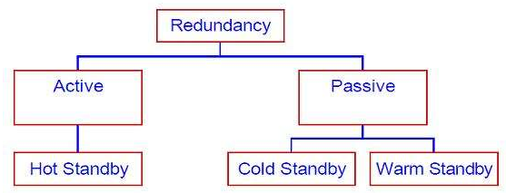
4.4.3 Spare
Spare: A standby spare must be rebooted to the appropriate software configuration and have its state initialized when a failure occurs.
The downtime for this tactics is usually minutes.
64

Slide 42
4.4.4 Checkpoint/rollback
Checkpoint/rollback: A checkpoint is a recording of a consistent state created either periodically or in response to specific events
Sometimes a system fails in an unusual manner, In this case, the system should be restored using a previous checkpoint of a consistent state
For example, Windows start use last correct configuration
64

Slide 43
4.4.5 Exception Handling
Exception handling: Once an exception has been detected, the system must handle it in some fashion
Return error codes
Exception classes that contain information helpful in fault correlation, such as name, origin and the cause of the exception
64

Slide 44
4.4.6 State resynchronization
State resynchronization: The passive and active redundancy tactics require the component being restored to have its state upgraded before its return to service
64

Slide 45
4.4.7 Software upgrade
Software upgrade: Its’ goal is to achieve in-service upgrades to executable code images in a non-service-affecting manner
There are three realized methods
Function patch ( bug fix )
Class patch ( bug fix )
Hitless in-service ( new features and capabilities )
64

Slide 46

4.5 Fault Prevention
The system could prevent the fault from occurring in the first place
There are five categories tactics
Removal from service
Transactions
Predictive model
Exception prevention
Increase competence set
64

Slide 47
4.5.1 Removal from service
removal from service: This tactic removes a component of the system from operation to undergo some activities to prevent anticipated failures
One example is rebooting a component to prevent memory leaks from causing a failure
If this removal from service is automatic, an architectural strategy can be designed to support it
64

Slide 48
4.5.2 Transaction
Transactional semantics to ensure than asynchronous messages exchanged between distributed components are atomic, consistent, isolated, and durable(ACID) properties
The most common realization of the transactions tactic is two-phase commit protocol
This tactic prevents race conditions caused by two processed attempting to update the same data item
64

Slide 49
4.5.3 Predictive Model
A predictive model monitors the state of health of a system process to ensure that the system is operating within its nominal operating parameters, for example
Session establishment rate
Maintaining statistics for process ( in service, out of service, idle etc.)
Message queue length statistics
It is used to predict the onset of faults
64

Slide 50
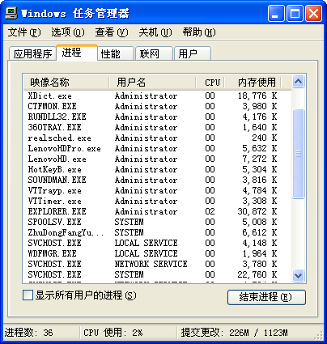
4.5.4 Exception prevention
Exception prevention refers to techniques employed for the purpose of preventing system exceptions from occurring
Use of wrappers to prevent faults
Exception detection
64

Slide 51
4.6 Summary Availability Tactics
Availability
Fault Detection
Recovery-Preparation and Repair
Recovery-Reintroduction
Prevention
Fault Masked or Repair Made
Ping/Echo
Monitor
Heartbeat
Sanity Checking
Timestamp
Exception Detection
Voting
Self-Test
Active Redundancy
Passive Redundancy
Spare
Rollback
Exception Handling
Software Upgrade
Degradation
Shadow
State Resynchronization
Escalating Restart
Non-Stop Forwarding
Removal from Service
Transactions
Predictive Model
Exception Prevention
Increase Competence Set
Fault
Availability tactics
64

Slide 52
5 A Design for Availability
The design for availability include:
Allocation of responsibilities
Coordination model
Data model
Mapping among architectural elements
Resource management
Binding time
Choice of technology
64

Slide 53
5.1 Allocation of Responsibilities
It ensures that additional responsibilities have been allocated to detect an omission, crash, incorrect timing, or incorrect response
Log the fault
Notify appropriate entities
Disable the source of events causing the fault
Be Temporarily unavailable
Fix or mask the fault/failure
Operate in a degrade mode
64

Slide 54
5.2 Coordination Model
Ensure that coordination mechanisms can detect an omission, crash, incorrect timing and response
Ensure that coordination mechanisms enable the logging of the fault, notification etc.
Ensure that coordination model supports the replacement of the artifacts used
Determine if the coordination will work under conditions of degraded communication
64

Slide 55
5.3 Data Model
Determine which data abstractions, along with their operations or their properties, could cause a fault
For example, ensure that write requests are cached if a server is temporarily unavailable and performed when the server is returned to service
64

Slide 56
5.4 Mapping among Architectural Elements
Determine which artifacts may produce a fault
Ensure that the mapping of architectural elements is flexible enough to permit the recovery from the fault, include:
Which processes on failed processors need to be reassigned at runtime
Which processor, data stores can be activated or reassigned at runtime
How to assign runtime elements to processors
64

Slide 57
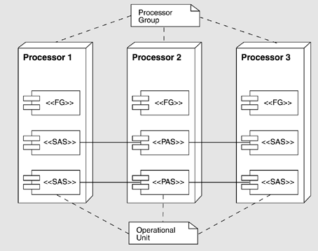
5.4.1 Mapping Example
Functional groups (FG), operational units, processor groups, and primary/standby address spaces
64

Slide 58
5.4 Resource Management
Determine what critical resources are necessary to continue operation in the presence of a fault
Determine the availability time for critical resources
For example, ensure that input queues are large enough to buffer anticipated messages if a server fails
64

Slide 59
5.6 Binding Time
Determine how and when architectural elements are bound. For example:
Late binding is used to switch between artifacts
Late binding is used to change the definition or tolerance of a fault
What are the availability characteristics of the late binding mechanism itself? Can it fail?
64

Slide 60
5.7 Choice of Technology
Determine the available technologies that can detect faults, recover from faults, or reintroduce failed components
Determine the availability characteristics of chosen technologies themselves: What faults can the recover from? What faults might they introduce into the system
64

Slide 61
Summary
Availability refers to the ability of the system to be available for use, especially after a fault occurs
Tactics for availability are categorized into:
Detect faults
Recover from faults
Prevent faults
All of the availability tactics involve the coordination model because it must be aware of faults that occur to generate a response
64

Slide 62
Homework
Write a set of concrete scenarios for availability using each of the possible responses in the general scenario
Redundancy is often cited as a key strategy for achieving high availability. Look at the tactics presented in this chapter and decide how many of them exploit some form of redundancy and how many do not
64

Slide 63

Discuss
Whether or not does agile process need the architecture ?
(Reference chapter 15)
64

Slide 64

Discuss
How does the cloud service realize the high availability?
Reference the chapter 26 ”Architecture in the Cloud”
64

